Slide 1


Smart Mobility Engineering Lab (IGS3231) Week 2 Lecture
ISE Department
Prof. Mehdi Pirahandeh

Slide 2
Content
Introduction to Embedded System Design
Application Examples
Q & A
Survey

Slide 3
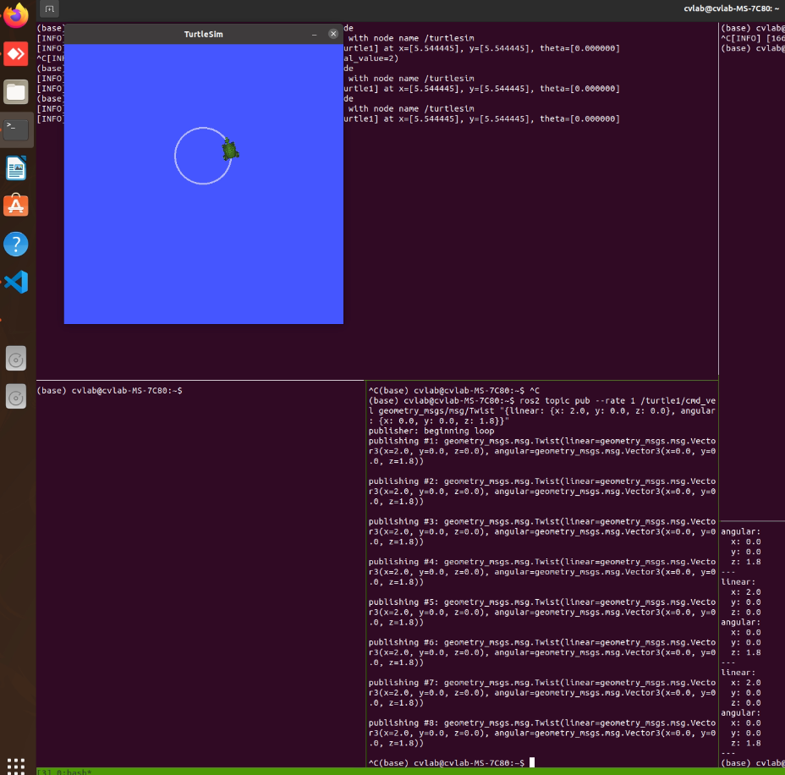
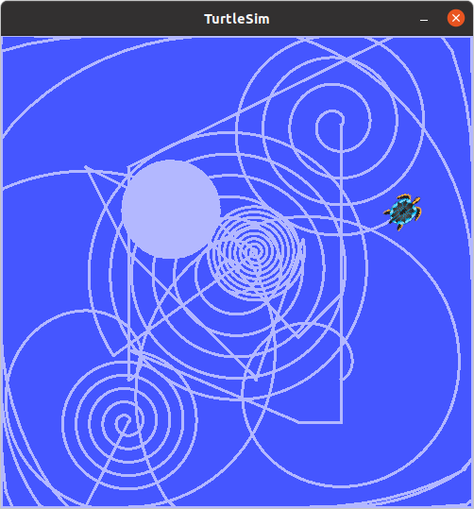
Using turtlesim
Turtlesim is a lightweight simulator for learning ROS 2. It illustrates what ROS 2 does at the most basic level, to give you an idea of what you will do with a real robot or robot simulation later on.

Slide 4
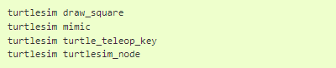
Using turtlesim
Install turtlesim
Make sure your system is up-to-date
sudo apt update
Install the turtlesim library
sudo apt install ros-rolling-turtlesim
Check that the package installed:
ros2 pkg executables turtlesim
The above command should return a list of turtlesim’s executables:

Slide 5
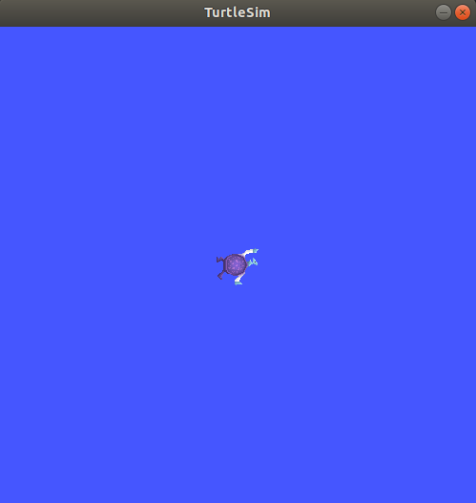
Using turtlesim
Start Turtlesim
To start turtlesim, enter the following command in your terminal:
ros2 run turtlesim turtlesim_node
The simulator window should appear, with a random turtle in the center.

Slide 6
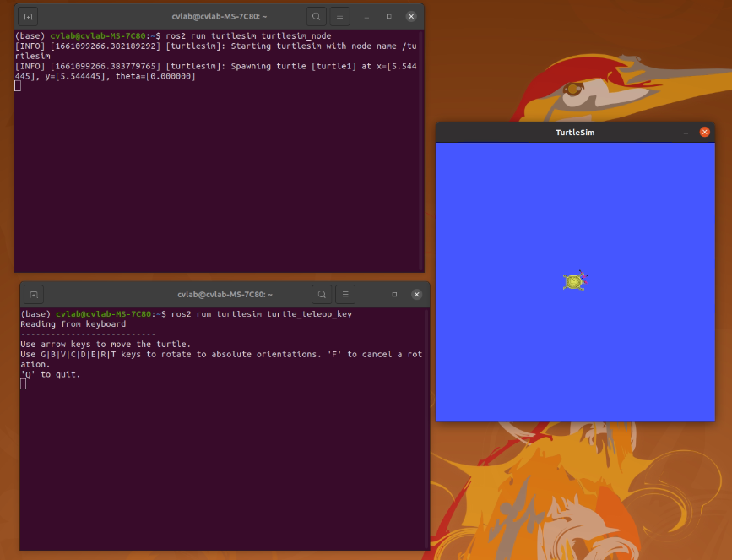
Using turtlesim
Use Turtlesim
To control the turtle type the following command:
ros2 run turtlesim turtle_teleop_key
At this point you should have three windows open: a terminal running turtlesim_node, a terminal running turtle_teleop_key and the turtlesim window.
Use the arrow keys on your keyboard to control the turtle. It will move around the screen, using its attached “pen” to draw the path it followed so far.

Slide 7
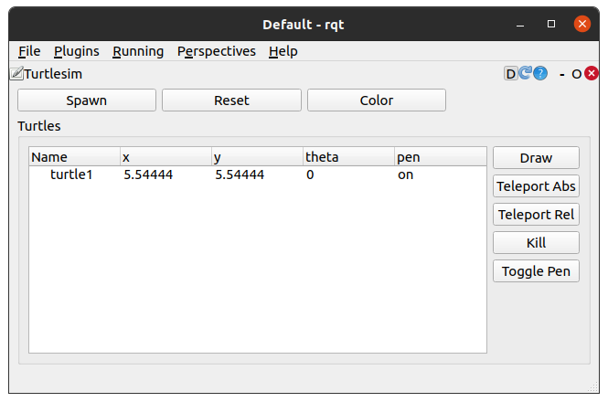
Using rqt
rqt is a GUI tool for ROS 2. Everything done in rqt can be done on the command line, but it provides an easier, more user-friendly way to manipulate ROS 2 elements.

Slide 8
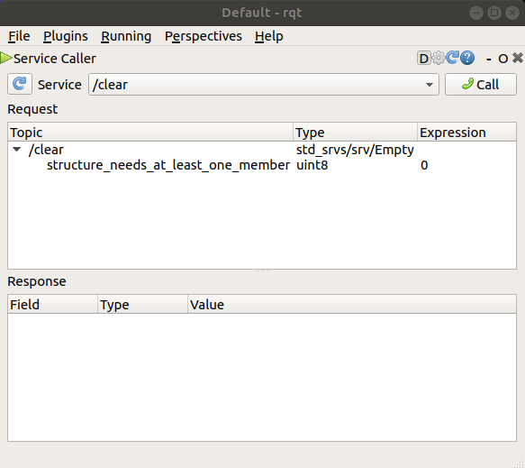
Using rqt
Install rqt
Make sure your system is up-to-date
sudo apt update
Install the rqt library and its plugins
sudo apt install ~nros-rolling-rqt*
Using rqt
To run rqt just type rqt in command line
After running rqt the first time, the window will be blank. No worries; just select Plugins > Services > Service Caller from the menu bar at the top.

Slide 9
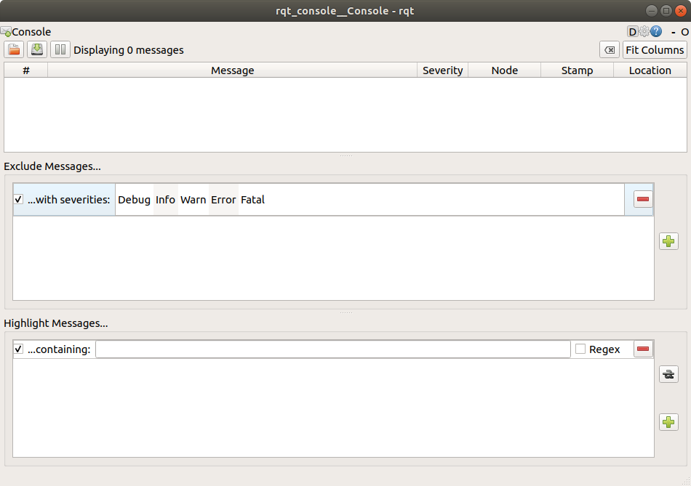
Using rqt_console to view logs
rqt_console is a GUI tool used to introspect log messages in ROS 2.
To start rqt_console in a new terminal with the following command:
ros2 run rqt_console rqt_console
The first section of the console is where log messages from your system will display.
In the middle you have the option to filter messages by excluding severity levels.
The bottom section is for highlighting messages that include a string you input.

Slide 10
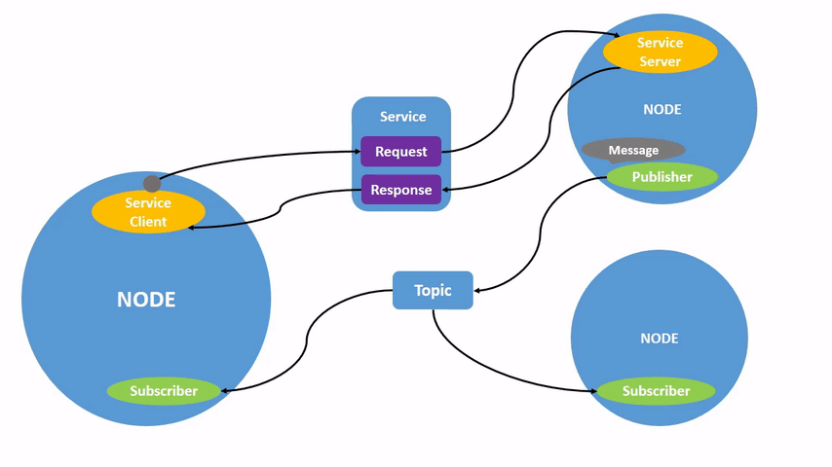
Understanding nodes
ROS2 Graph
The ROS graph is a network of ROS 2 elements processing data together at one time. It encompasses all executables and the connections between them if you were to map them all out and visualize them.
Nodes in ROS2
Each node in ROS should be responsible for a single, module purpose (e.g. one node for controlling wheel motors, one node for controlling a laser range-finder, etc). Each node can send and receive data to other nodes via topics, services, actions, or parameters.

Slide 11
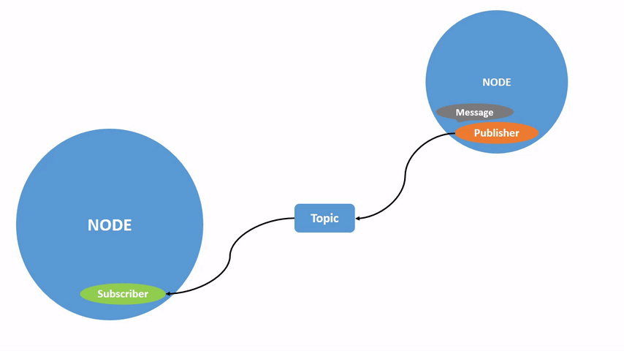
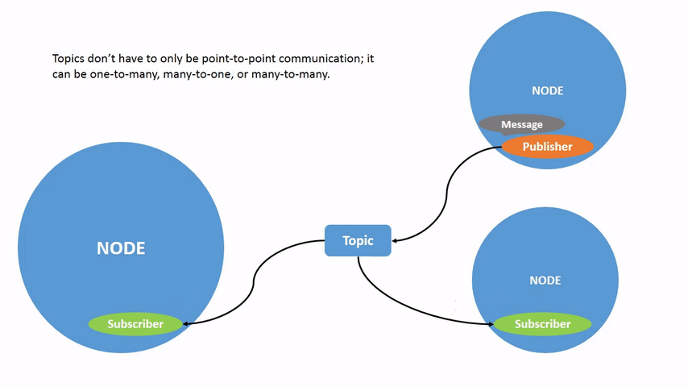
Understanding Topics
ROS 2 breaks complex systems down into many modular nodes. Topics are a vital element of the ROS graph that act as a bus for nodes to exchange messages.
Topics are one of the main ways in which data is moved between nodes and therefore between different parts of the system.

Slide 12
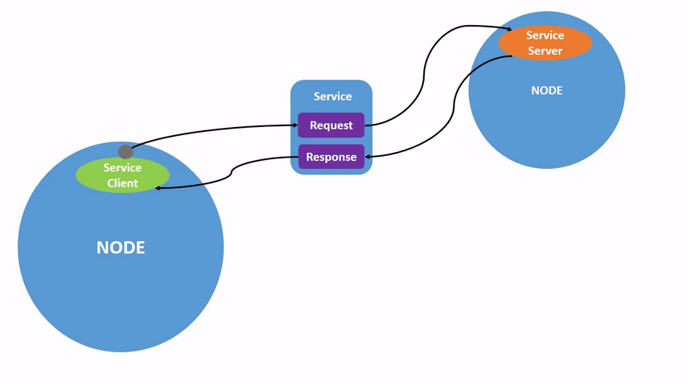
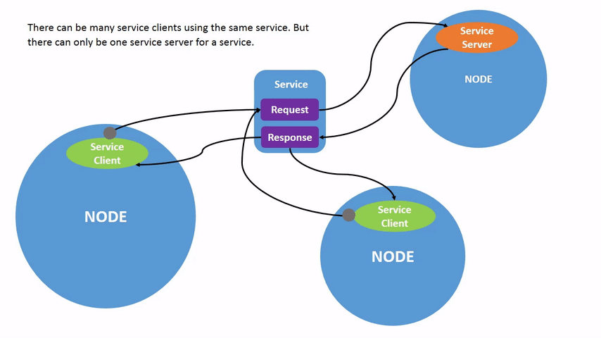
Understanding services
Services are another method of communication for nodes in the ROS graph. Services are based on a call-and-response model, versus topics’ publisher-subscriber model. While topics allow nodes to subscribe to data streams and get continual updates, services only provide data when they are specifically called by a client.

Slide 13
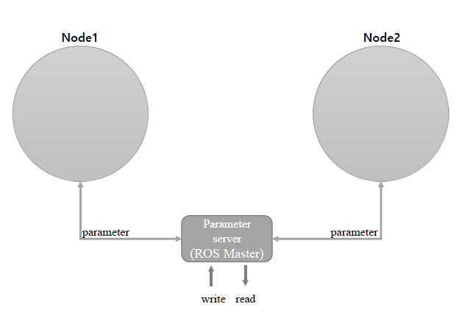
Understanding Parameters
A parameter is a configuration value of a node. You can think of parameters as node settings. A node can store parameters as integers, floats, booleans, strings, and lists. In ROS 2, each node maintains its own parameters.

Slide 14
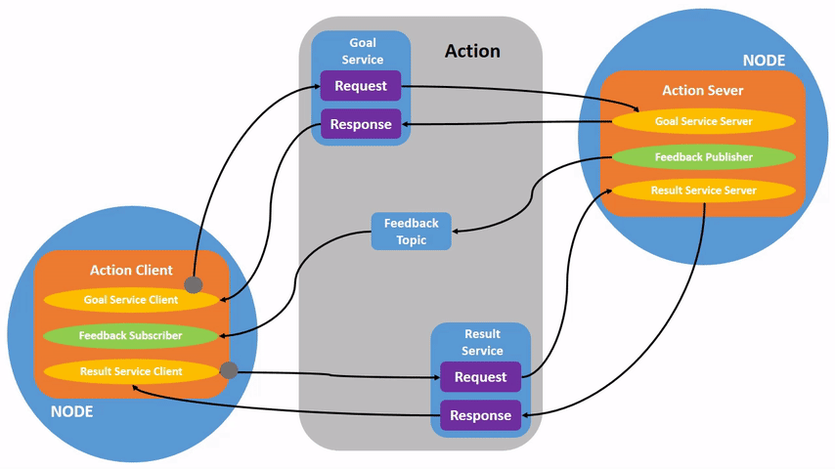
Understanding Actions
Actions are one of the communication types in ROS 2 and are intended for long running tasks. They consist of three parts: a goal, feedback, and a result.
Actions are built on topics and services. Their functionality is similar to services, except actions can be canceled. They also provide steady feedback, as opposed to services which return a single response.

Slide 15
Using colcon to build packages
Colcon is an iteration on the ROS build tools catkin_make, catkin_make_isolated, catkin_tools, and ament_tools
Installing Colcon
sudo apt install python3-colcon-common-extensions
A ROS workspace is a directory with a particular structure.
Colcon does out of source builds. By default, it will create the following directories as peers of the src directory:
The build directory will be where intermediate files are stored. For each package a subfolder will be created in which e.g., CMake is being invoked.
The install directory is where each package will be installed to. By default, each package will be installed into a separate subdirectory.
The log directory contains various logging information about each colcon invocation.

Slide 16
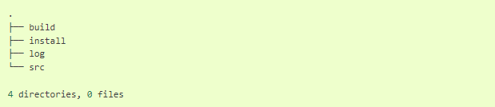
Using colcon to build packages
Create a workspace
mkdir -p ~/ros2_ws/src
cd ~/ros2_ws
Add some sources
git clone https://github.com/ros2/examples src/examples -b rolling
Build the workspace
colcon build --symlink-install
After the build is finished, we should see the build, install and log directories

Slide 17
Using colcon to build packages
Source the environment
When colcon has completed building successfully, the output will be in the install directory. Before you can use any of the installed executables or libraries, you will need to add them to your path and library paths. colcon will have generated bash/bat files in the install directory.
. install/setup.bash
Create your own Package
For convenience, you can use the tool ros2 pkg create to create a new package based on a template.
Setup
The command colcon_cd allows you to quickly change the current working directory of your shell to the directory of a package.
echo "source /usr/share/colcon_cd/function/colcon_cd.sh" >> ~/.bashrc
echo "export _colcon_cd_root=/opt/ros/rolling/" >> ~/.bashrc

Slide 18
Creating a workspace
A workspace is a directory containing ROS 2 packages. Before using ROS 2, it’s necessary to source your ROS 2 installation workspace in the terminal. This makes ROS2’s packages available for you to use in that terminal.
Step 1: Source ROS 2 environment
source /opt/ros/rolling/setup.bash
Step 2: Create a new Directory
mkdir -p ~/ros2_ws/src
cd ~/ros2_ws/src
Step 3: Clone Github repo
git clone https://github.com/ros/ros_tutorials.git -b rolling-devel
Step 4: Resolve dependencies
rosdep install -i --from-path src --rosdistro rolling -y

Slide 19
Creating a workspace
Step 5: Build the workspace with colcon
colcon build
Step 6: Source the overlay
source /opt/ros/rolling/setup.bash
cd ~/ros2_ws
. install/local_setup.bash
Step 7: Modify the overlay
You can modify turtlesim in your overlay by editing the title bar on the turtlesim window. To do this, locate the turtle_frame.cpp file in ~/ros2_ws/src/ros_tutorials/turtlesim/src. Open turtle_frame.cpp with your preferred text editor. On line 52 you will see the function setWindowTitle("TurtleSim");. Change the value ”TurtleSim” to ”MyTurtleSim” and save the file. Return to the second terminal (where the overlay is sourced) and run turtlesim again:
ros2 run turtlesim turtlesim_node

Slide 20
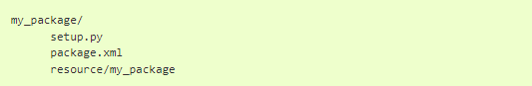
Creating a package
What is ROS2 Package?
A package can be considered a container for your ROS 2 code. If you want to be able to install your code or share it with others, then you’ll need it organized in a package. With packages, you can release your ROS 2 work and allow others to build and use it easily.
What makes up a ROS 2 package?
package.xml file containing meta information about the package
setup.py containing instructions for how to install the package
setup.cfg is required when a package has executables, so ros2 run can find them
/<package_name> - a directory with the same name as your package, used by ROS 2 tools to find your package, contains __init__.py
The simplest possible package may have a file structure that looks like:

Slide 21
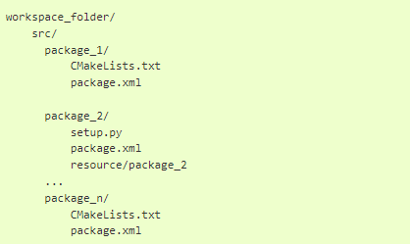
Creating a package
Packages in Workspace
A single workspace can contain as many packages as you want, each in their own folder. You can also have packages of different build types in one workspace (CMake, Python, etc.). You cannot have nested packages
A trivial workspace might look like:

Slide 22
Creating a package
Step1: Create a package
Make sure you are in the src folder before running the package creation command.
cd ~/ros2_ws/src
The command syntax for creating a new package in ROS 2 is:
ros2 pkg create --build-type ament_python <package_name>
Step 2: Build a package
colcon build
Step 3: Source the setup file
. install/local_setup.bash

Slide 23
Creating a package
Step 4: Use the package
ros2 run my_package my_node
Step 5: Examine the package contents
Inside ros2_ws/src/my_package , you will see the files and folders that ros2 pkg create automatically generated:
Step 6: Customize package.xml
You may have noticed in the return message after creating your package that the fields description and license contain TODO notes
Input your name and email on the maintainer line.
Edit the description line to summarize the package
Update the licence line

Slide 24
Writing a simple publisher and subscriber
In this practice, you will create nodes that pass information in the form of string messages to each other over a topic. The example used here is a simple “talker” and “listener” system; one node publishes data and the other subscribes to the topic so it can receive that data.
Step 1: Create a package
ros2 pkg create --build-type ament_python py_pubsub
Step 2: Write the publisher node
Download the example talker code by entering the following command
wget https://raw.githubusercontent.com/ros2/examples/rolling/rclpy/topics/minimal_publisher/examples_rclpy_minimal_publisher/publisher_member_function.py
Now there will be a new file named publisher_member_function.py adjacent to __init__.py.

Slide 25
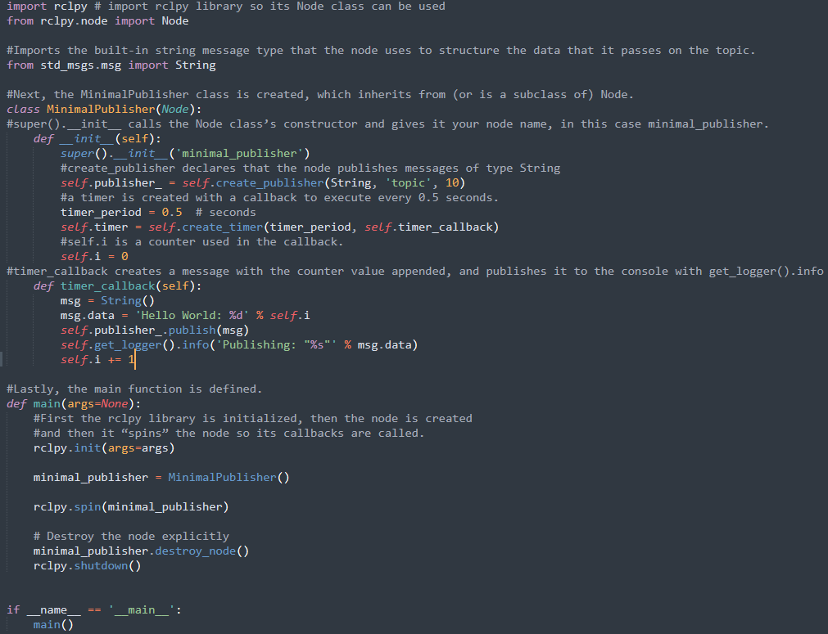
Writing a simple publisher and subscriber
Step 2.1 Examine the code

Slide 26
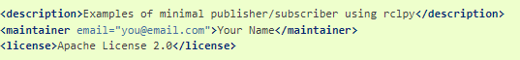
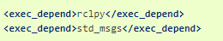
Writing a simple publisher and subscriber
2.2 Add Dependencies
1:
2:
3:
After the lines above, add the following dependencies corresponding to your node’s import statements:
Navigate one level back to the ros2_ws/src/py_pubsub
directory, where the setup.py, setup.cfg, and package.xml
files have been created for you.
Open package.xml with your text editor.
Make sure to fill in the <description>, <maintainer> and <license> tags:
This declares the package needs rclpy and std_msgs when its code is executed.

Slide 27
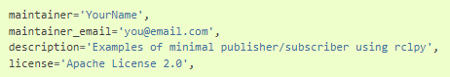
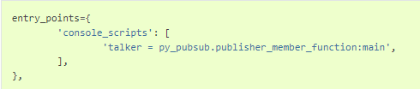
Writing a simple publisher and subscriber
2.3 Add an entry point
1:
2:
Open the setup.py file. Again, match the maintainer, maintainer_email,
description and license fields to your package.xml:
Add the following line within the console_scripts brackets of the entry_points field:

Slide 28
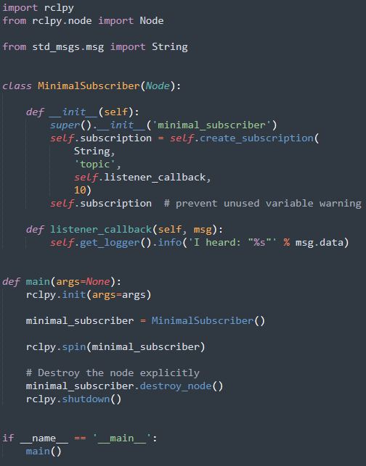
Writing a simple publisher and subscriber
Step 3: Write subscriber node
Return to ros2_ws/src/py_pubsub/py_pubsub to create the next node. Enter the following code in your terminal:
wget https://raw.githubusercontent.com/ros2/examples/rolling/rclpy/topics/minimal_subscriber/examples_rclpy_minimal_subscriber/subscriber_member_function.py

Slide 29
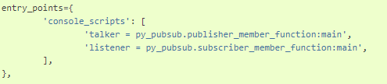
Writing a simple publisher and subscriber
3.2 Add an entry point
Reopen setup.py and add the entry point for the subscriber node below the publisher’s entry point. The entry_points field should now look like this:
Step 4: Build and run
1: rosdep install -i --from-path src --rosdistro rolling –y
2: colcon build --packages-select py_pubsub
3: . install/setup.bash
4: ros2 run py_pubsub talker
5: ros2 run py_pubsub listener

Slide 30
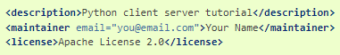
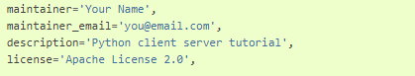
Writing a simple service and client
Step 1: Create a package
1: ros2 pkg create --build-type ament_python py_srvcli --dependencies rclpy example_interfaces
Update
make sure to add the description, maintainer email and name, and license information to package.xml
Add the same information to the setup.py file for the maintainer, maintainer_email, description and license
fields:

Slide 31
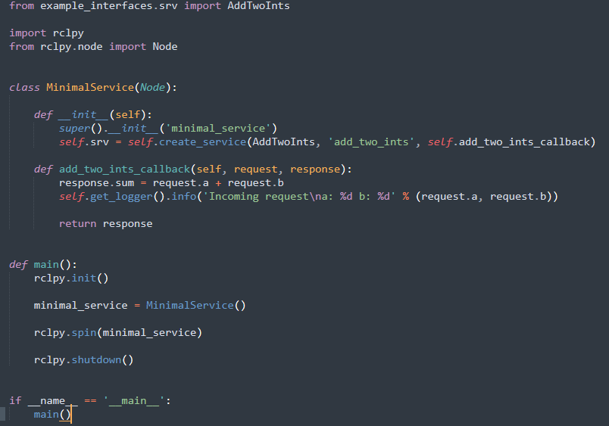
Writing a simple service and client
Step 2: Write the service node
Step 2.2 Add an entry point

Slide 32
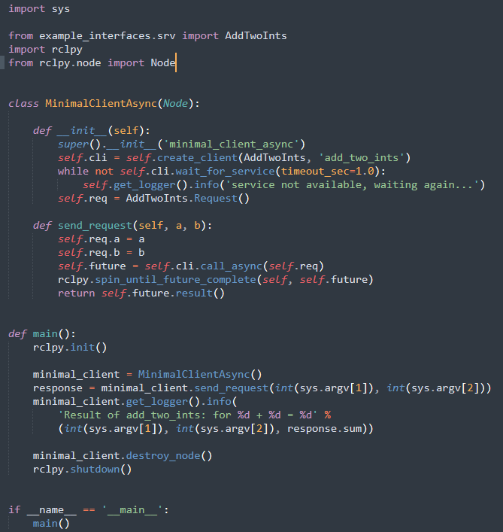
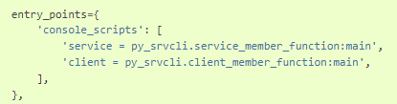
Writing a simple service and client
Step 3: Write the client node
Step 3.2 Add an entry point

Slide 33
Writing a simple service and client
Step 4: Build and run
Check for missing dependencies before building:
1: rosdep install -i --from-path src --rosdistro rolling –y
Navigate back to the root of your workspace, ros2_ws, and build your new package:
2: colcon build --packages-select py_srvcli
Open a new terminal, navigate to ros2_ws, and source the setup files:
3: . install/setup.bash
Now run the service node: The node will wait for the client’s request.
4: ros2 run py_srvcli service
Start the client node, followed by any two integers separated by a space:
5: ros2 run py_srvcli client 2 3

Slide 34
Creating custom msg and srv files
Goal: Define custom interface .msg and .srv use them with Python nodes.
In previous cases you learned how to use predefined interfaces for writing simple publisher/subscriber and service/client using Python. But sometimes it is required to write custom methods as well. In this lesson we will learn how to build custom interface definitions.
Step 1: Create a new package
ros2 pkg create --build-type ament_cmake tutorial_interfaces
Create separate directories for .msg and .srv
mkdir ms and mkdir srv
Step 2: Create custom definitions
2.1 msg definitions
Make a new file with one line of code ------ int64 num
Make a new file called Sphere.msg -- geometry_msgs/Point center and float64 radius
2.2 srv definition
Back in the tutorial_interfaces/srv directory you just created, make a new file called AddThreeInts.srv with the following request and response structure: int64 a int64 b int64 --- int64 sum this is your custom service that requests 3 integers

Slide 35
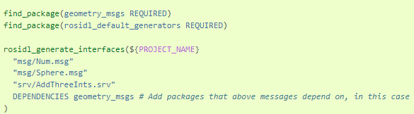
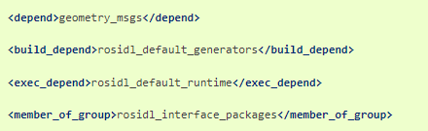
Creating custom msg and srv files
Step 3: Cmakelists.txt
To convert the interfaces, you defined into language-specific code(like C++ and Python) so that they can be used in those languages, add the following lines to CMakeLists.txt:
Step 4: package.xml
Add the following lines to package.xml

Slide 36
Creating custom msg and srv files
Step 5: Build the tutorial_interfaces package
Now that all the parts of your custom interfaces package are in place, you can build the package. In the root of your workspace (~/ros2_ws), run the following command:
colcon build --packages-select tutorial_interfaces
Step 6: Confirm msg and srv creation
In a new terminal, run the following command from within your workspace (ros2_ws) to source it:
. install/setup.bash
To confirm the creation of interface run
“ros2 interface show tutorial_interfaces/msg/Num”
Step 7: Test the new interfaces
For this step you can use the packages you created in previous tutorials. A few simple modifications to the nodes, CMakeLists and package files will allow you to use your new interfaces.
7.1 Testing Num.msg with pub/sub
With some slight modifications to the publisher/subscriber package created in a previous tutorial you can see Num.msg in action. Since you’ll be changing the standard string msg to a numerical one, the output will be slightly different.

Slide 37
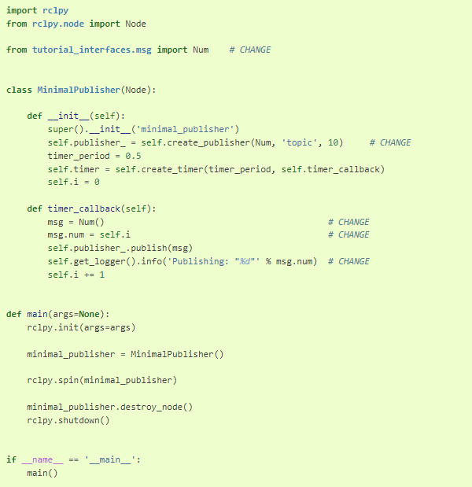
Creating custom msg and srv files
Publisher:

Slide 38
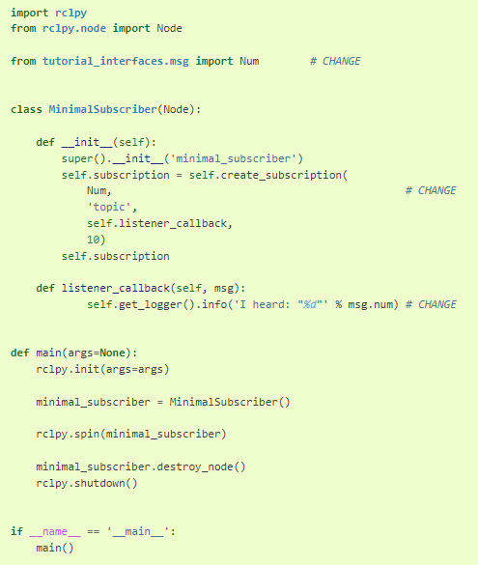
Creating custom msg and srv files
Subscriber:

Slide 39
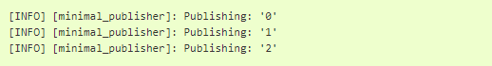
Creating custom msg and srv files
package.xml:
Add the following line:
<exec_depend>tutorial_interfaces</exec_depend>
After making the above edits and saving all the changes, build the package:
colcon build --packages-select py_pubsub
Then open two new terminals, source ros2_ws in each, and run:
ros2 run py_pubsub talker
ros2 run py_pubsub listener
Since Num.msg relays only an integer, the talker should only be publishing integer values, as opposed to the string it published previously:

Slide 40
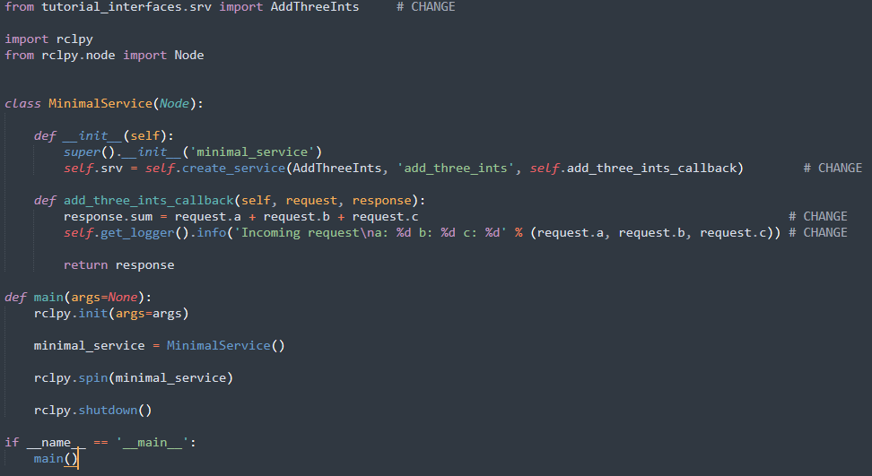
Creating custom msg and srv files
7.2 Testing AddThreeInts.srv with service/client
With some slight modifications to the service/client package created in a previous tutorial (C++ or Python), you can seeAddThreeInts.srv in action. Since you’ll be changing the original two integer request srv to a three integer request srv, the output will be slightly different.
Service:

Slide 41
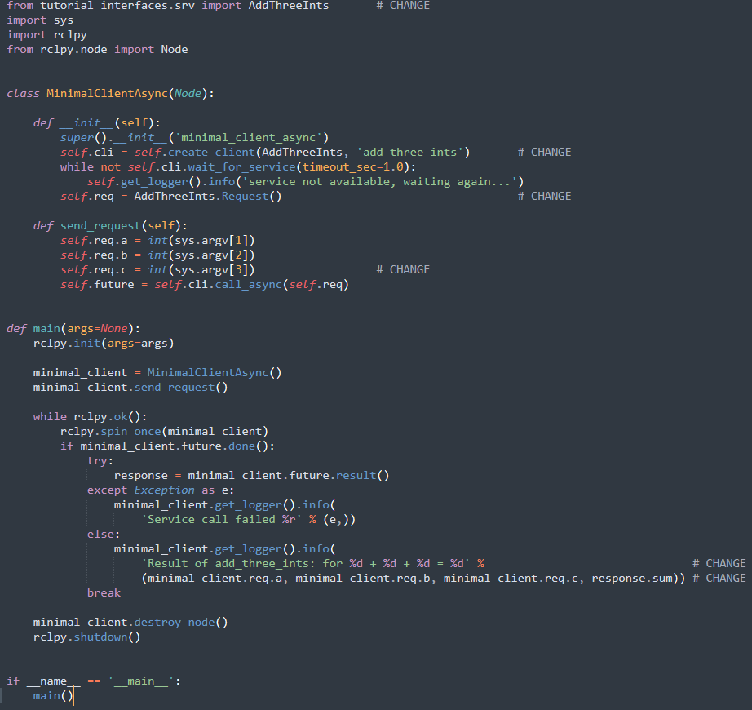
Creating custom msg and srv files
Client:

Slide 42
Creating custom msg and srv files
Package.xml:
Add the following line:
<exec_depend>tutorial_interfaces</exec_depend>
After making the above edits and saving all the changes, build the package:
colcon build --packages-select py_srvcli
Then open two new terminals, source ros2_ws in each, and run:
ros2 run py_srvcli service
ros2 run py_srvcli client 2 3 1

Slide 43
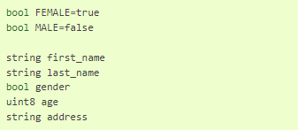
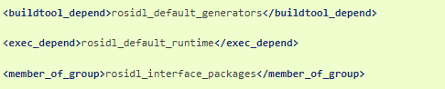
Implementing custom interfaces
Goal: Learn more ways to implement custom interfaces in ROS 2
Step 1: Create a package
In your workspace src directory, create a package more_interfaces and make a folder within it for msg files:
ros2 pkg create --build-type ament_cmake more_interfaces
mkdir more_interfaces/msg
Step 2: Create a msg file
Inside more_interfaces/msg, create a new file AddressBook.msg Paste the following code to create a message meant to carry information about an individual:
2.1 Build a msg file
Open package.xml, and add the following lines:

Slide 44
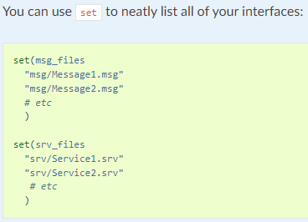
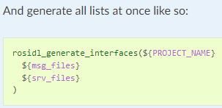
Implementing custom interfaces
Open CMakeLists.txt and add the following lines:
Find the package that generates message code from msg/srv files:
find_package(rosidl_default_generators REQUIRED)
Declare the list of messages you want to generate:
set(msg_files "msg/AddressBook.msg")
By adding the .msg files manually, we make sure that CMake knows when it has to reconfigure the project after you add other .msg files.
rosidl_generate_interfaces(${PROJECT_NAME}${msg_files})
Also make sure you export the message runtime dependency:
ament_export_dependencies(rosidl_default_runtime)
2.2 Set multiple interfaces

Slide 45
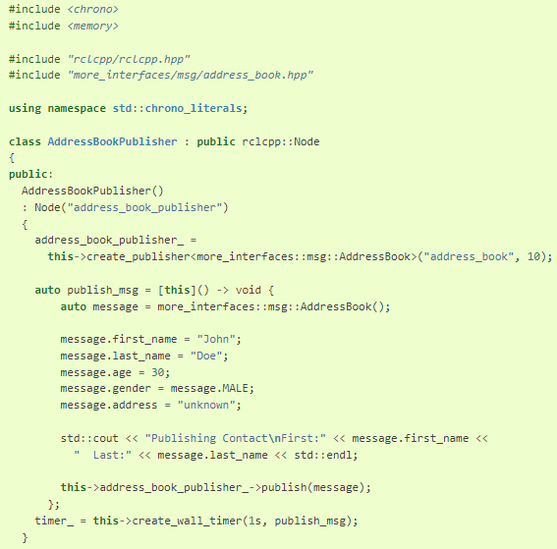
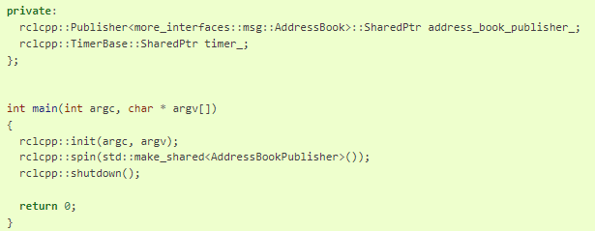
Implementing custom interfaces
Step 3: Use an interface from the same package
Now we can start writing code that uses this message.
In more_interfaces/src create a file called publish_address_book.cpp and paste the following code:
Continuation:

Slide 46
Implementing custom interfaces
Step 4: Try it out
Return to the root of the workspace to build the package:
cd ~/ros2_ws
colcon build --packages-up-to more_interfaces
Then source the workspace and run the publisher:
. install/local_setup.bash
ros2 run more_interfaces publish_address_book
To confirm the message is being published on the address_book topic, open another terminal, source the workspace, and call topic echo
. install/setup.bash
ros2 topic echo /address_book

Slide 47
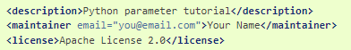
Using parameters in a class
Goal: Create and run a class with ROS parameters using Python (rclpy).
Step 1: Create a package
Recall that packages should be created in the src directory, not the root of the workspace. Navigate into ros2_ws/src and create a new package:
ros2 pkg create --build-type ament_python python_parameters --dependencies rclpy
Your terminal will return a message verifying the creation of your package python_parameters and all its necessary files and folders.
The --dependencies argument will automatically add the necessary dependency lines to package.xml and CMakeLists.txt.
Step 1.1 Update package.xml
Because you used the --dependencies option during package creation, you don’t have to manually add dependencies to package.xml or CMakeLists.txt.
As always, though, make sure to add the description, maintainer email and name, and license information to package.xml.

Slide 48
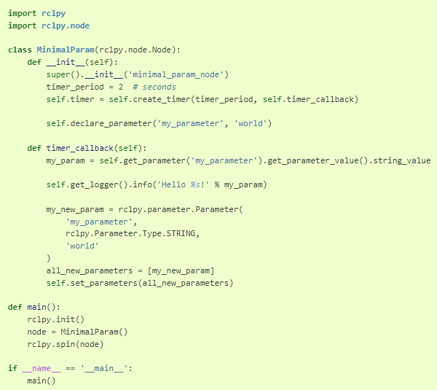
Using parameters in a class
Step 2: Write the Python node
Inside the ros2_ws/src/python_parameters/python_parameters directory, create a new file called python_parameters_node.py and paste the following code within:

Slide 49
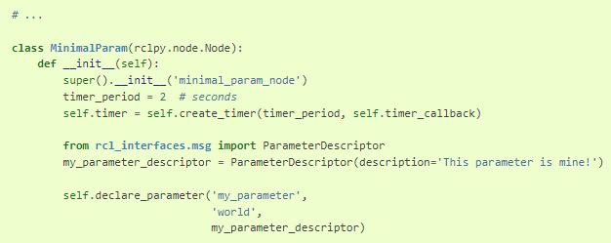
Using parameters in a class
Step 2.1.1 Add ParameterDescriptor
Optionally, you can set a descriptor for the parameter. Descriptors allow you to specify a text description of the parameter and parameters constraints, like making it read-onlyspecifying a range, etc. For that to work, the __init__ code has to be changed to:
The rest of the code remains the same. Once you run the node, you can then run ros2 param describe /minimal_param_node my_parameter to see the type and description.

Slide 50
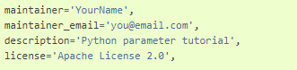
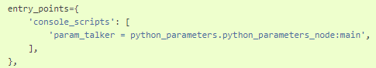
Using parameters in a class
2.2 Add an entry point
Open the setup.py file. Again, match the maintainer, maintainer_email, description and license fields to your package.xml:
Add the following line within the console_scripts brackets of the entry_points field:
Don’t forget to save.

Slide 51
Using parameters in a class
Step 3: Build and Run
It’s good practice to run rosdep in the root of your workspace (ros2_ws) to check for missing dependencies before building
rosdep install -i --from-path src --rosdistro foxy –y
Navigate back to the root of your workspace, ros2_ws, and build your new package:
colcon build --packages-select python_parameters
Open a new terminal, navigate to ros2_ws, and source the setup files:
. install/setup.bash
Now run the node:
ros2 run python_parameters param_talker
The terminal should return the following message every 2 seconds:

Slide 52
Using parameters in a class
Changing Parameter
Step 1: Make sure the node is running:
ros2 run python_parameters param_talker
Step 2: Open another terminal, source the setup files from inside ros2_ws again, and enter the following line:
ros2 param list
There you will see the custom parameter my_parameter. To change it simply run the following line in the console:
ros2 param set /minimal_param_node my_parameter earth
You know it went well if you get the output Set parameter successful. If you look at the other terminal, you should see the output change to [INFO] [minimal_param_node]: Hello earth! Since the Python talker then set the parameter back to world, further outputs show [INFO] [minimal_param_node]: Hello world!

Slide 53
Using ros2doctor to identify issues
Goal: Identify issues in your ROS 2 setup using the ros2doctor tool.
Step 1 Check up your setup
1. Run --- ros2 doctor. If everything is correct you should see All <n> checks passed
However, it’s not unusual to have a few warnings returned. A UserWarning doesn’t mean your setup is unusable; it’s more likely just an indication that something is configured in a way that’s not ideal.
If ros2doctor only finds warnings in your system, you will still receive the All <n> checks passed message.
Step 2: Check a system
You can also examine a running ROS 2 system to identify possible causes for issues. To see ros2doctor working on a running system, let’s run Turtlesim, which has nodes actively communicating with each other.
Start up the system by opening a new terminal, sourcing ROS 2, and entering the command:
ros2 run turtlesim turtlesim_node
Open another terminal and source ROS 2 to run the teleop controls:
ros2 run turtlesim turtle_teleop_key
Now run ros2doctor again in its own terminal. You will see the warnings and errors you had the last time you ran ros2doctor on your setup, if you had any. Following those will be a couple new warnings relating to the system itself:

Slide 54
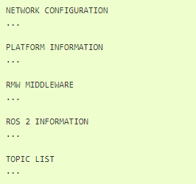
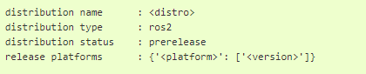
Using ros2doctor to identify issues
Step 3: Get a full report
To get a full report, enter the following command in the terminal:
ros2 doctor –report
Which will return a list of information categorized into five groups:
You can crosscheck the information here against the warnings you get from running ros2 doctor. For example, if ros2doctor returned the warning (mentioned earlier) that your distribution is “not fully supported or tested”, you might take a look at the ROS 2 INFORMATION section of the report:

Slide 55
Brief break (if on schedule)
Q&A?
Prof. Mehdi pirahandeh
E-mail : mehdi at inha dot ac dot kr

